Slide 1
Week 2: Debugging Help
Welcome Question – What is your favorite outdoor activity?
Start asking as soon as you are settled, remember to introduce yourself / names. By the time class starts – you should be able to list some of the activities of those people sitting around you!

Slide 2
Introductions
Name
Major/Minor
Favorite Food
Favorite Hobby

Slide 3
Coding is Like Music
To be successful in CS 1
Work ahead of the schedule
Go through the modules
Try the lab before going to the lab day!
Practice often (daily)
Get help when you are stuck
Keep practicing
Memorization
Won’t help you!
You can’t memorize problem solving
You have to practice Divide-Conquer-Glue
You are learning a different way to think more than anything!
That can be heard but know once you learn it – you will never look at things the same again!

Slide 4

What is Computer Science? (Discussion)

Slide 5
What is Computer Science?
I daresay you haven’t had much practice,” said the Queen. “When I was your age, I always did it for half-an-hour a day. Why, sometimes I’ve believed as many as six impossible things before breakfast.”
Alice in Wonderland
Computer Science is…
Solving real world problems using technology as our means to solve them.
Corollary: Computer Sciences seek to improve the world around them by attempting to solve some of the world’s unsolvable problems.
HOMEWORK (ok, suggestion): Spend the next week,
documenting things you think would be better,
and that how many computers could improve them
Come with at least six ”problems/opportunities” that you would like to see improved to next week

Slide 6
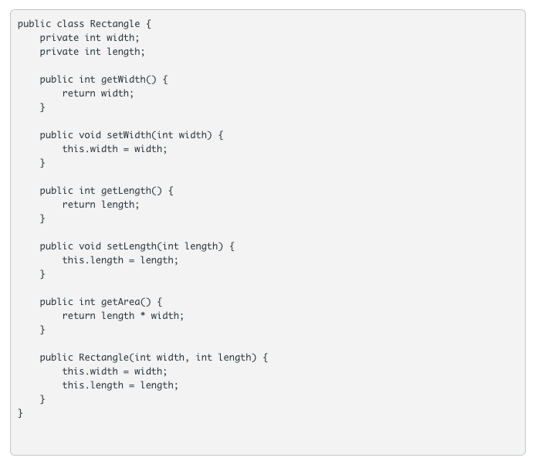
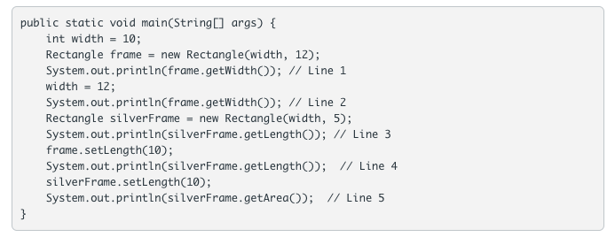
Knowledge Check: Working Together

Slide 7
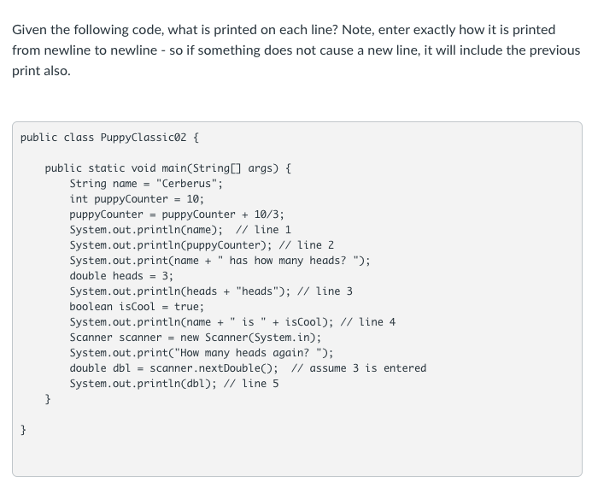
Knowledge Check: Working Together
Notes:
TAs – remember, System.in triggers a new line as they are typing first!
Line 1: Cerberus
Line 2: 13
Line 3: Cerberus has how many heads? 3.0heads
Line 4: Cerberus is true
Line 5: 3.0
(note the last one – feel free to run this one in a *terminal*, if you get a lot of questions)

Slide 8
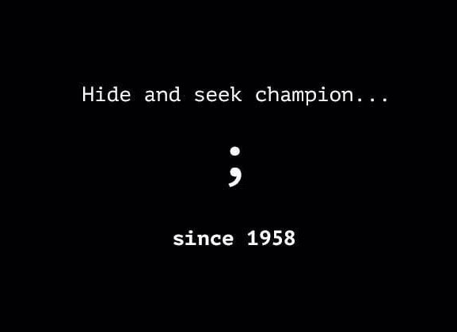
Debugging Code
Code in zybooks – to follow along with!
Compile Errors
bad syntax
missing semicolon (bane of all coders)
missing curly brackets
Runtime Errors
Crashes while running
Logic Errors
Poor logic
Works, but not as intended
Solution
code only a few lines at a time
run after a few lines
even if running doesn’t do much!
Methods help you group code
Debug and test methods as you write
Let’s look at some examples

